Slide 1
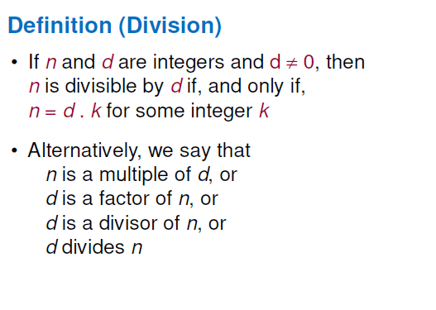

Slide 2
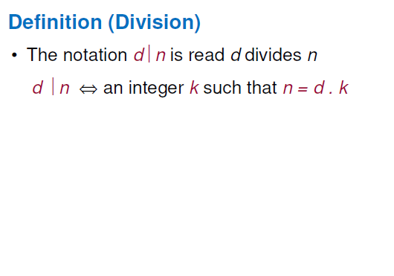
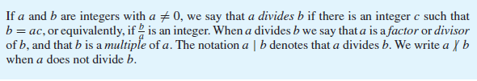

Slide 3
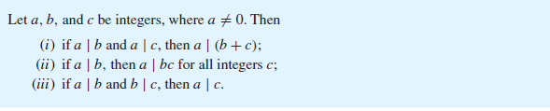

Slide 4
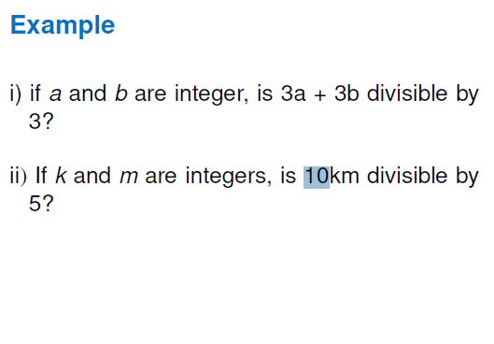

Slide 5
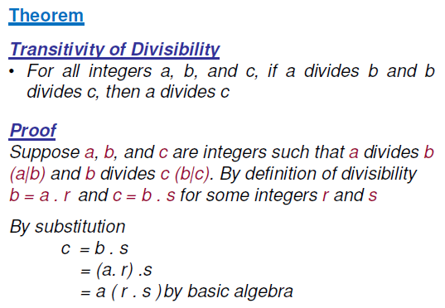

Slide 6
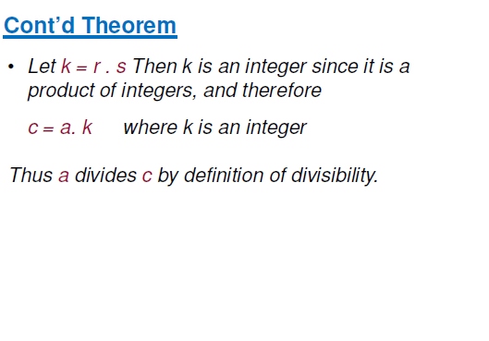

Slide 7
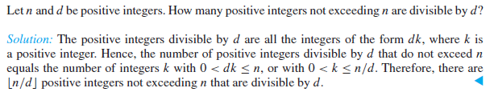

Slide 8
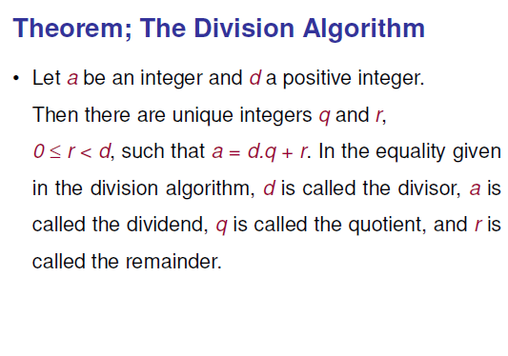

Slide 9
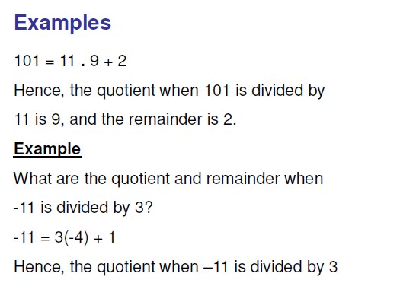

Slide 10
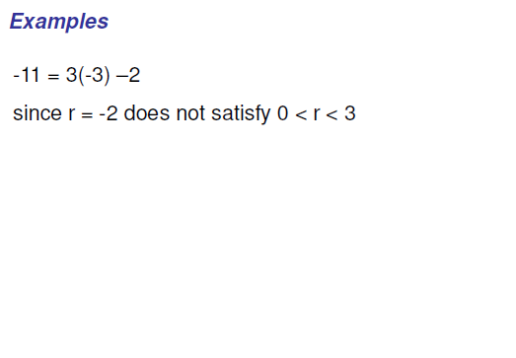

Slide 11
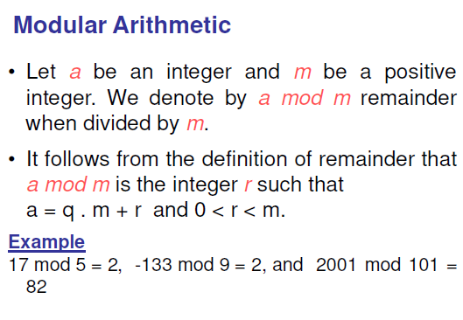

Slide 12
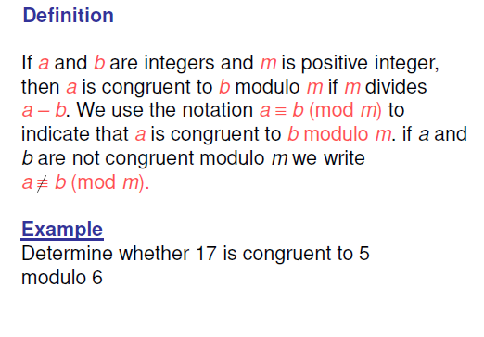
Notes:
24 and 14 are congruent mod 6 ?

Slide 13
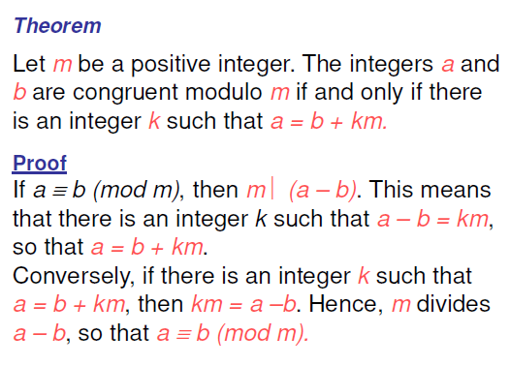

Slide 14

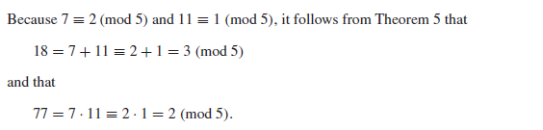
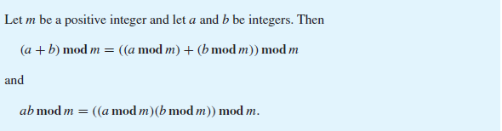

Slide 15
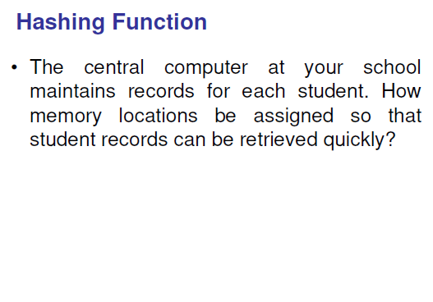

Slide 16
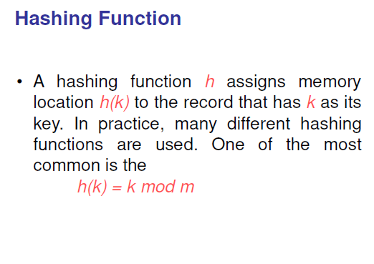
Notes:
Hashing function should be onto. So that all memory locations are possible

Slide 17
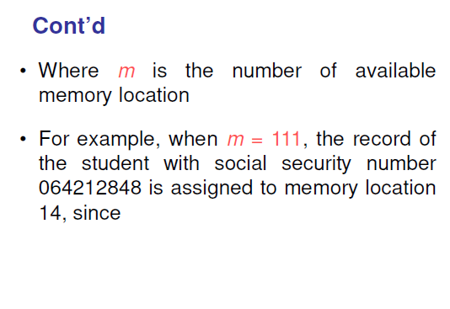

Slide 18
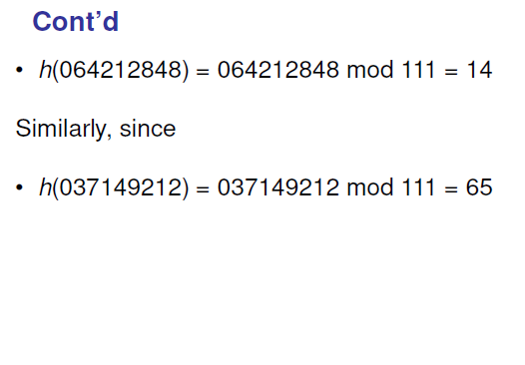
Notes:
Hashing function is not one to one, because there are more possible keys than memory locations, more than one file may be assigned to a memory location, so there can occur a collision. One way to resolve collision is to assign the first free location following the occupied memory location assigned by the hashing function. For example, after making two earlier assignments, we assign location 15 to the record of the customer with SSN 107405723. to see this, first note that h(k) maps this SSN to location 14, because
H(107405723) = 107405723 mod 11 = 14
But this is already occupied by 064212848
However memory location 15 the first location following memory location 14 is free.

Slide 19
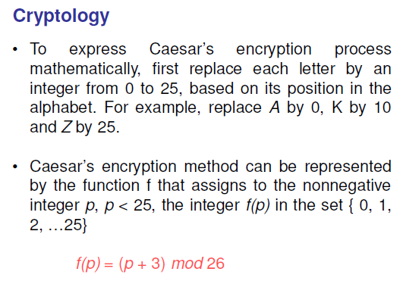

Slide 20
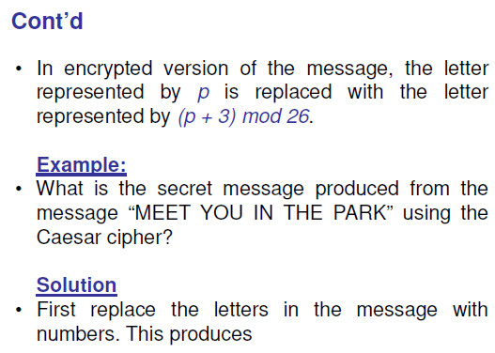

Slide 21
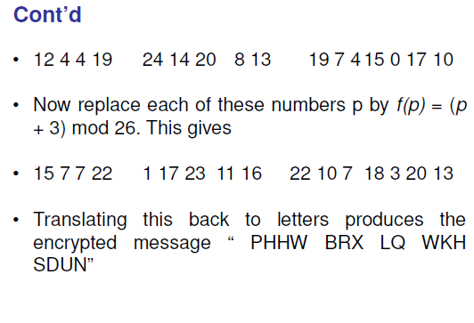

Slide 22
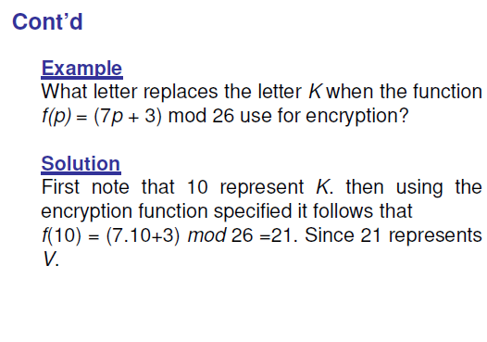

Slide 23
Pseudorandom Numbers
Needed for computer simulation
Generated by systematic methods
Procedure is called linear congruential method
We choose four integers
Modulus m,
Multiplier a, 2 <= a < m
Increment c, 0 <= c < m
Seed x₀ , 0 <= x₀ < m
X_{n+1} = (ax_{n} + c ) mod m
Notes:
Because x9 = x0 and because each term depends only on the previous term, this sequence is generated
3,7,8,6,1,2,0,4,5, 3,7,8,6,1,2,0,4,5,3, . . . . .

Slide 24
Pseudorandom Numbers
m=9, a=7, c=4 and x₀ = 3
x₁ = 7x₀ + 4 mod 9 = 7.3 + 4 mod 9 = 25 mod 9 = 7
x₂ = 7x₁ + 4 mod 9 = 7.7 + 4 mod 9 = 53 mod 9 = 8
x₃ = 7x₂ + 4 mod 9 = 7.8 + 4 mod 9 = 60 mod 9 = 6
x₄ = 7x₃ + 4 mod 9 = 7.6 + 4 mod 9 = 46 mod 9 = 1
x₅ = 7x₄ + 4 mod 9 = 7.1 + 4 mod 9 = 11 mod 9 = 2
x₆ = 7x₅ + 4 mod 9 = 7.2 + 4 mod 9 = 18 mod 9 = 0
x₇ = 7x₆ + 4 mod 9 = 7.0 + 4 mod 9 = 4 mod 9 = 4
x₈ = 7x₇ + 4 mod 9 = 7.4 + 4 mod 9 = 32 mod 9 = 5
x₉ = 7x₈ + 4 mod 9 = 7.5 + 4 mod 9 = 39 mod 9 = 3

